Slide 1


Using the NECDMC Case Studies to Teach Scientific Research Data Management
ACRL NEC Scholarly Communication Interest Group
Teaching RDM with NECDMC workshop
May 8, 2014
Donna Kafel, RN, MLIS
e-Science Project Coordinator
Lamar Soutter Library
University of Massachusetts Medical School

Slide 2
Overview of Presentation
Value of Case Studies
Tour of Research Cases section of NECDMC
Simplified Data Management Plan
Teaching guides/resources
Ways to teach with cases
A sampling of research cases
Selecting cases
Summary
Q & A

Slide 3
Case Study Approach
“The case method packs more experience into every hour of learning than any other instructional approach.”
Harvard Business Publishing,
Hints for Case Teaching
Notes:
Many students are more inductive than deductive reasoners—that is to say they learn better from examples than from logical development starting with basic principles. The use of case studies can therefore be a very effective classroom technique—highlighting relevant research data mgmt. concepts into teachable moment.
Best practices of RDM apply across all disciplines, but the use of teaching cases
has been recognized for their value in emphasizing certain RDM
Issues for students conducting research in specific disciplines. The cases can also be used to illustrate specific data management issues that arise in a research setting.
Instructors teaching RDM will find that by using case studies they can achieve more discipline specific tailoring for homogenous groups. Many wonder whether RDM instruction needs to be discipline specific. It’s been estimated that 20% of RDM instruction can be tailored to specific audiences. The other 80% includes generic RDM best practices that applies to all disciplines.

Slide 4

An Overview of NECDMC’s Research Cases page
Notes:
Demonstrate the Research Cases section of the curriculum.
Point out the Simplified Data management plan—which is also in attendees folders. Discuss the fact that the Simplified Data Management plan was taken from the National Science Foundations recommendations for a data management plan. Each of the research case studies illustrate some of the data management practices referred to in the Simplified Data Management plan.
Review the Research Data Management Concepts and Issues Illustrated in the Teaching Cases document—and advise that this may be helpful if you’re looking to address a specific topic such as keeping a lab notebook or managing multiple data formats.
Show the link “How to Teach RDM using cases”—point out the collection of cases, statement inviting users to submit their cases—and note the list of case related activities and assessments for the curriculum’s modules
The link, “Demonstration of Teaching with a Research Case” are slides from a similar workshop that we taught last November—they illustrate the data and the data management practices in the research case “Regeneration of Functional Heart Tissue in Rats” and map them to the simplified data management plan.
Point out the components (Summary of teaching points, case, discussion questions related to the different modules) of a research case (use first one—Outcomes from Orthopedic Implant Surgery

Slide 5
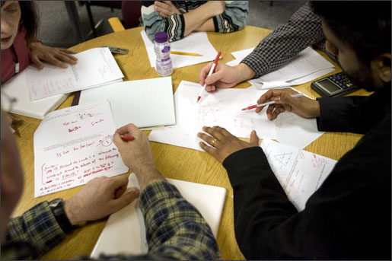
Approaches to Teaching with Cases
Flipped classroom
Integrated into lectures
Group work and breakout sessions
Homework
Activities in module
lesson plans
One case over series of
classes
Notes:
There are several ways to teach with the research cases. A case could be assigned using the flipped classroom model in which students are asked to read the case and answer or reflect about the case’s discussion questions prior to class---and then be prepared to discuss it in class. The cases, or excerpts of the cases can be integrated into a lecture to illustrate the lecture’s salient points. Students can read and discuss the case in breakout sessions and report back to the class, develop data management plans and recommendations for best data practices for the cases. In some of the curriculum’s modules, there are case based activities built into the lesson plan. For example, an activity in Module 1 is for students to create a data management plan for one of the cases using the simplified data management plan template discussed on page 10-11. An activity for module 3 is for students to read a research case and identify and discuss the basic project information that could be documented using metadata.
If you are teaching a series of classes over several days, weeks or a semester long course, you could take one research case and use it to illustrate a different RDM issue for each topic—you could take a case and use it in the module 1 overview, module 2—address the contextual details in the data from that case module 3—storage and backup practices , ect

Slide 6
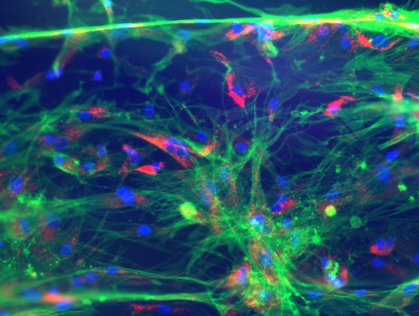
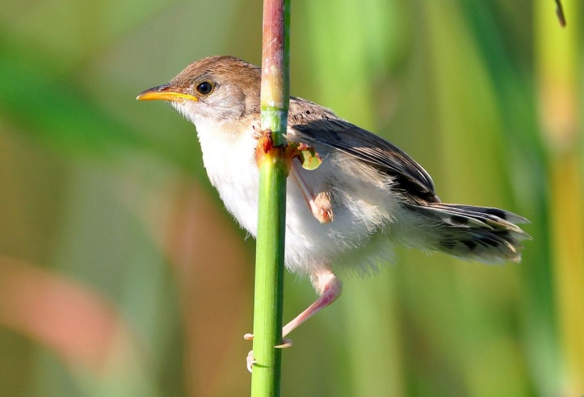
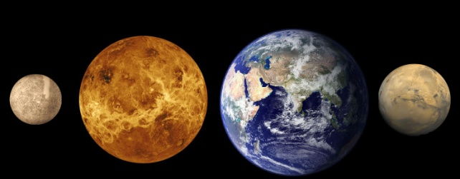
A Sampling of Cases
Habitat Selection by Grassland Birds, Their Habitat Requirements and Informing Grassland Bird Conservation
Regeneration of Functional Heart Tissue in Rats
Characterizing a Component of a Rocket Engine used to Control Satellites in Orbit
Data Preservation Case Study: The ALIEnS Project
Notes:
Each of the research cases is an actual depiction of a research case in a specific research environment. The cases have been developed to make it easier for science, health sciences and technology students at the undergraduate and graduate levels to understand data management principles and challenges in the context of familiar research settings. They also help library students and librarians visualize various research settings and how data is used, generated, and managed in these research settings. We designed the cases in the curriculum so that you can pick and choose and customize the cases to the needs of your audience.
It is important to note that each research case is unique—just as every research project is unique. The types of data, instrumentation, variables, practices of research personnel vary greatly from one research setting to another—this is why data management plans cannot be cloned—each case is unique onto itself.
I would also like to point out to you that while the cases were written to cover data management issues that map to the Simplified Data Management plan—many of the cases often only cover a few components of the data management plan—such as the types of data generated, how data is stored and use of contextual details. Other components such as provisions for privacy or plan for archiving data may not be covered in a specific research case. The fact that it is not covered however, can be a point of discussion and students could be given an assignment to create a scenario that addresses these missing data management plan components.
Over the next several slides, I’ll be showing you a sampling of four very different research cases. Many of describe multiple data management issues –but in the interest of time, I’ll highlight some key RDM issues described in each case.

Slide 7

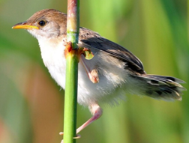
Habitat Selection by Grassland Birds Case Data
Field study observations
Data related to measurable variables
GPS data
Using above data, student creates simulations that create data models that in turn, create more data
Notes:
We’ll start with a life science field study case: Habitat Selecton by Grassland Birds Case Data.
In this case, a PhD student is conducting research on grassland bird habitat quality. He collects the following data:
Field study observations—including measurements of the height of vegetation, leaf litter depth, flight initiation distance
Data related to openness of the landscape
GPS data: location coordinates, angles to the horizon, distances to the habitat’s edges, compass bearings
The research case’s description of the types of data that is collected corresponds to Number one component on the data management plan. “What types of data will you be creating or capturing? Experimental measures, observational, etc.

Slide 8

Grassland Birds Case Data Formats
DMP #1Types of Data,
Instruments, software
DMP #2:
File formats
Hard copies entered onto computer
Used Juno Trimble
Excel sheets
ArcGIS
Analyzed data with SAS
Downloaded GPS data
Processed downloaded data with Python and SAS
.doc files for data descriptions and write-ups
.xls and .xlsx files for spreadsheets and data tables
.shp files for geographic information with associated data tables
.csv files for both data tables and geographic info, these are easier to read with R and Python than .xls, .xlsx, and .shp files
py, .sas, and .r files contain scripts that processed and analyzed other data or computed statistics
Notes:
This graphic denotes the use of various formats of data that have been collected during the span of the grassland birds case project. The case notes that early on in his research the student recorded data using hard copy data sheets that he then had to enter into a computer. Eventually the student began using a portal computer (called the Trimble Juno GPS and entered observational data and GIS data into MS Excel spreadsheets and a proprietary mapping software program, ArcGIS. The data on the spreadsheets and the ArcGIS were analyzed using SAS software. In addition to the data that the student collected from the field, he has downloaded existing GIS data from the internet, and processed these files using ArcGIS and Python software, and analyzed them using Python and SAS software.
The student uses:
.doc files for data descriptions and write-ups
.xls and .xlsx files for spreadsheets and data tables
.shp files for geographic information with associated data tables
.csv files for both data tables and geographic info, these are easier to read with R and Python than .xls, .xlsx, and .shp files
py, .sas, and .r files contain scripts that processed and analyzed other data or computed statistics
As noted in the blue balloon at the top—this information about data formats used in the case correspond to the first and second component on the data management plan—a description of how the data is captured and processed is the first requirement --contextual details –in this case the file formats--needed to make data meaningful to others is the second requirement

Slide 9
Grassland Birds Case Data Storage
DMP #3
Storage, Backup and Security
Hard copy data sheets: Binders (binders for self, and copies of binders in PI’s lab)
Electronic files: lab’s space on institutional server and external hard drive (both backed up)
Notes:
The case provides a basic description of how the files are stored. Hard copy data sheets are kept in two binders—one for the student and a copy of a binder in the PI’s lab.
Electronic files are stored on his lab’s space on the university’s servers—which the university stores and backs up. The student also has a backup copy in an external hard drive that he regularly backs up.
One discussion point about the student’s storage and backup practices is would he consider developing a plan for syncing data that is stored on university servers and the external drive.

Slide 10
Grassland Birds Metadata
DMP #2: Metadata, contextual details
No formal protocol
Data guide created for some folders(guide files start with 0 are listed at top of directory)
Not every folder has a guide file and existing guide files not kept up to date
Notes:
This grassland birds case notes that the student does not have a formal protocol for metadata but that he has created guide files with file names that leads with 0s so that they are at the top of the directory. These files have some documentation and description of the files in each of his folders. An issue here is that the student’s use of metadata and provision of contextual information is inconsistent. He has not made a guide file for all of his files and folders, and he does not always keep them up to date.

Slide 11
Grassland Birds Case Data Sharing and Citation
DMP #6: policies for access and sharing
The student recognizes that he is benefitting from the availability of public data, which he is repurposing for his own research, and he would also like to share his data. There are no formal restrictions placed on his data for reuse, but he feels that he would like to be informed if someone else wanted to reuse his data, which he feels is the unspoken rule in his discipline.
Notes:
The conclusion of the birds case relays how the student would like to share his data as there are no formal sharing restrictions—and notes how the student would like to be informed if someone else wanted to reuse his data.
This aligns with the sixth component of the data management plan—policies for access and sharing—a point for student discussion or homework related to thiscould be “what process should be followed to gain future access to the researcher’s study data?”, or using the information from the case, note what components should be included in a data citation for a dataset from this project.

Slide 12
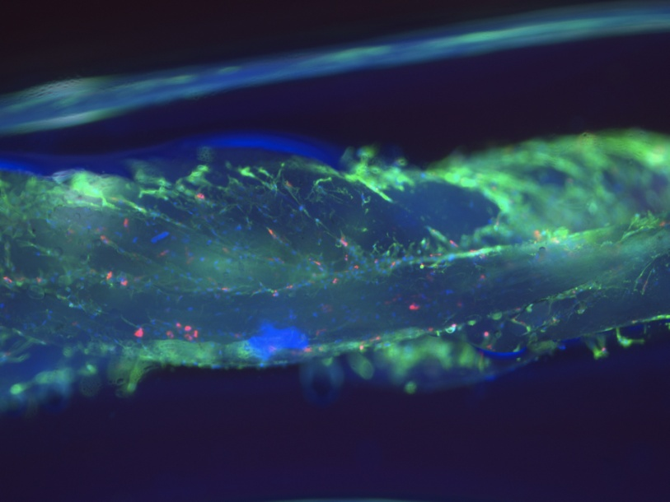
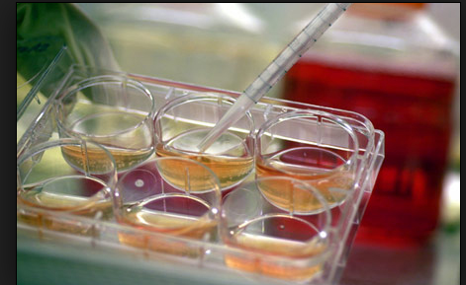
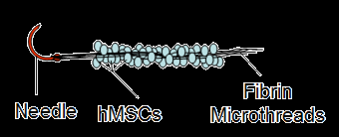
Regeneration of Functional Heart Tissue with Stem Cell Delivery
Biomedical lab case
Animal model experimentation
Data related to observations of function of heart muscle after stem cell implementation
Managing multiple formats of data
Ethics related to use of animals in research
Notes:
The second sample case is “Regenerated of Functional Heart Tissue with Stem Cell Delivery”. This is an actual depiction of a biomedical engineering lab research project at WPI. This is one of the longer cases in the NECDMC collection. It features a lot of different types of data including images, numerical data, tissue slides, heart tissue, contextual data such as stem cell identifiers, information about the animal model, use of homemade software to detect stem cell activity in areas where it’s been implanted in the heart. It also addresses challenge of working with multiple formats: an animal log, lab notebook, tissue slides, images from various instrumentation.

Slide 13
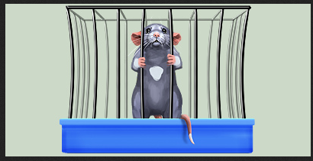
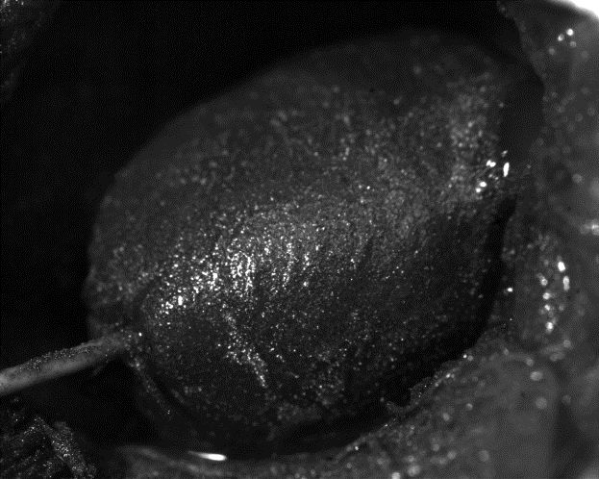
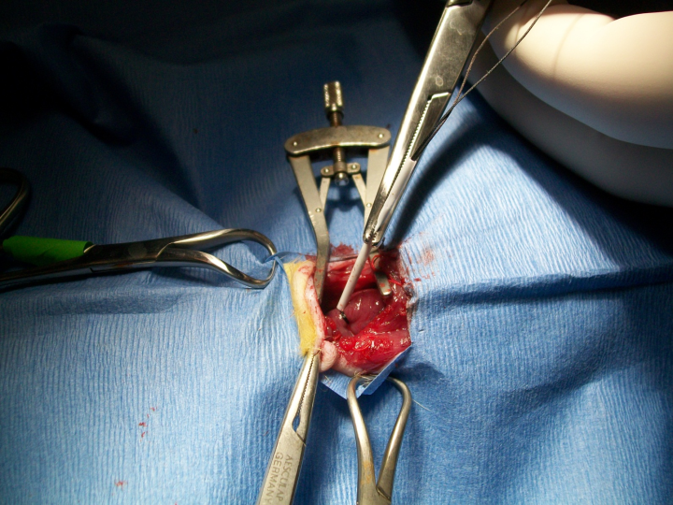
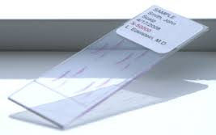
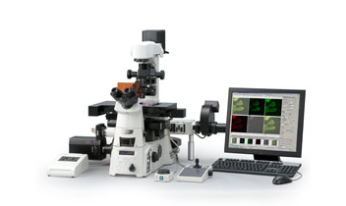
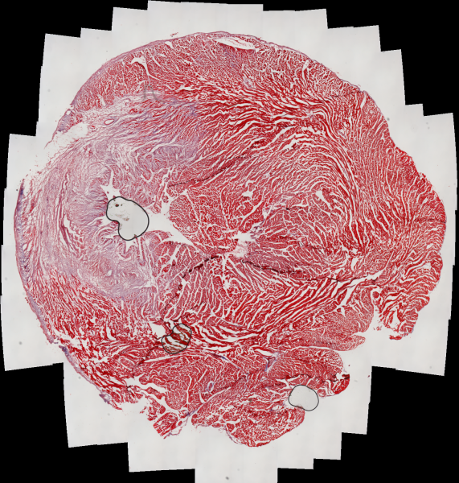
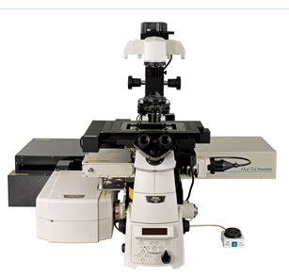
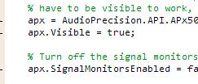
DMP #1
Types of Data (experimental), instruments, imaging software
Regeneration of Functional Heart Tissue with Stem Cell Delivery
Notes:
In the course of this case, there is a lot of data in several formats—images, numerical measurements, tissue slides, homemade code written by students that enable tracking of the nanofluorescent particles in the hear t tissue, contextual data such as the stem cell lines, model animal’s age, weight, instrumentation used in the implantation of the stem cells into the rat heart, names of students working on the experiment. The case gives an accurate description of the sheer volume of data that can be generated from a single instance of an animal experimentation.

Slide 14
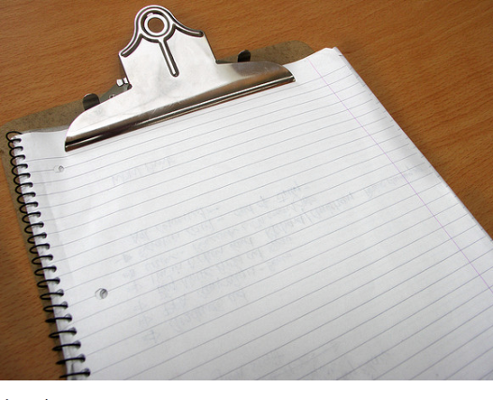
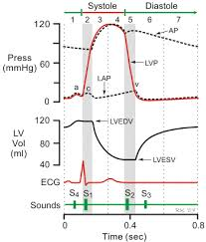
Regeneration of Functional Heart Tissue with Stem Cell Delivery
DMP #2
Contextual details, Metadata,
File formats
Data | File Format
Images | ?
Left ventricular pressure measurements | ?
Home made software | MATLAB or C
 | Slides—file name based on stain—example .act is actinin stain
Contextual | Paper lab notebook, animal log
DMP #4
Ownership of MATLAB code
Notes:
Students can learn a lot about the importance of file formatting as it relates to data generated by proprietary software, like the images of heart tissue that were taken by the camera in the confocal microscope. Can the images be converted to a non-proprietary format to ensure long-term access? Who owns the homemade software that the students wrote? What format is the software in? Is there a preservation friendly format that the MATLAB software code can be converted to ?

Slide 15
DMP #3
Storage, Backup and Security
Data Set | Storage
Optical images taken during Surgery: (~10,000 images) 1000 images for each data set | Hard drive acquisition computer > Drobo backup>hard drive of network computer backed up by institution
Left ventricular pressures (numeric) correlating with specific images | Same as above
Tissue sections | Slide boxes—could be in any of 3 or 4 freezers
Software | ?
Images from different stained tissue after second surgery | Drobo > DVD backups
Contextual data | Paper lab notebook (lab, PI’s office), surgical log (with animal)
Data Set
Notes:
Students may be all too familiar with this scenario in which data from a single animal model experiment is scattered in various locales—the optical images and ventricular pressure readings are initially stored in the instruments that generated them—then transferred to a self standing Drobo backup—and then saved on the hard drive of the networked computer that is regularly backed up by the institution.
The tissues slides are noted as being in 3 or 4 freezers—there is no designated one freezer for tissue slides from specific dates or experiments.
In order to track the fluorescent particles that provide information about the implanted stem cells,regeneration of heart tissue and heart muscle function: students write a homegrown software code with MATLAB. The case doesn’t mention where the code is being stored—if this code isn’t saved and backup up along with the other project data, the effectiveness of the stem cell delivery method on the regeneration of the heart tissue might not be able to be verified.

Slide 16
Characterizing a Component of a Rocket Engine used to Control Satellites in Orbit
An Engineering Testing Lab Case
Security restrictions
Legal and ethical issues
Data sharing issues
Homegrown analysis software
Fig. 1 50” x 72” vacuum chamber used for cathode research (WPI Higgins Laboratory)
Notes:
This is an actual case written by Laura Hanlan and an aerospace engineering researcher at WPI. It focuses on the study and characterization of a component of an electric thruster that is being used by NASA, the Air Force, and private companies to control satellites in orbit. Goal of this study is to enable researchers to build more robust thrusters that will have a longer service life than current models.
This case presents some interesting challenges in data management and sharing.

Slide 17
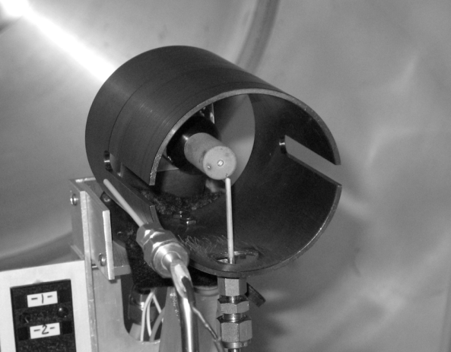
A Tale of Two Cathodes
DMP #6
Policies for access and sharing
Cathode 1
Cathode 2
From a private company
Developed with Air Force funding
ITAR regulations
From NASA
A laboratory use model
No ITAR regulations
Restrictions on publications related to cathode design
Notes:
In this case, there are 2 cathodes used in the testing lab. Cathode #1 is from a private company, was developed with Air Force funding, and is the same model as a unit which has been used operationally in orbit. Because it is identical to flight hardware, any work associated with this cathode must comply with International Traffic in Arms Regulations (ITAR) requiring that no foreign nationals have access to any aspect of the research. ITAR establishes strict controls on the use and dissemination of information related to defense articles. Some of the testing equipment and lab notebooks are kept locked up in order to comply.
Cathode #2 is from NASA and is intended to be a laboratory model (that is it is not flight hardware) It is not subject to the same ITAR restrictions—but it is subject to some NASA restrictions—specifically to the geometry and dimensions of the cathode.
These restrictions make it difficult to publish this type of research since the experiment would not be reproducible by other researchers unless they have access to the same devices.

Slide 18
DMP 4 & 5
Ownership Policies for re-use
Data in the Cathode Testing Lab
Raw data a laptop
Experimental conditions laboratory notebook
Students review data—discard some
Student produce code using MATLAB
Students share findings with researcher
Notes:
Data generated from the cathodes during experiments is downloaded onto a laptop. The experimental conditions are recorded in the lab notebook. To analyze the data,
The student write code using MATLAB. The MATLAB code is the intellectual property of the student and faculty advisor who create it. If code is written primarily by a student and the faculty advisor wants to share it with another research group, the advisor will attempt to contact the student and ask for permission.

Slide 19

DMP #7
Archiving and Preservation
Data Preservation Case Study: The ALIEnS Project
Large interdisciplinary research collaborative interested in preserving data, documents and supporting documents for reuse
Diverse data—collection consists of multiple iterations and minimal metadata
No preservation planning conducted
PI and project manager approach library for assistance and possible submission of data and documents to IR
Notes:
The Advanced Life-Support for Inhospitable Environments in Space (ALIEnS) was an interdisciplinary research center headquartered at Innovation Park at State Tech University. The purpose of ALIEnS was to investigate the best way to enable humans to live in the extreme environments of outer space for extended periods of time without the ability to resupply life-supporting essentials like oxygen, water, or food.
The ALIEnS project was interdiscpilinary and was comprised of researchers from agriculture, chemistry, civil engineering, food sciences, electrical computer engineering, mechanical engineering and other fields .Although headquartered at State Tech University, the ALIEnS project was a collaboration that included researchers from two other universities.
The ALIEnS project was funded by NASA and was expected to last for five years. However, the project fell victim to the budget cuts during the economic downturn and funding was withdrawn after three and a half years. This unexpected loss of funding caught ALIEnS unprepared. They were just beginning to bring the components of the project together and to test their closed loop model. The leadership of ALIEnS believes that funding could be restored in the future, and wants to reduce the risk of losing the results of the work that had already been completed. They are interested in preserving their data, documents, and other supporting materials so that when funding is restored they could easily resume their work, potentially with a new set of researchers and graduate students.

Slide 20
Points to consider when selecting a case(s):
Specific data management issues to be addressed
Your audience
Type of activity: class discussion, homework, breakout groups
Notes:
Selecting a case for your class? Consult the “Research Data Management Concepts and Issues Illustrated in the Teaching Cases” or look at the Summary of Teaching points listed at the beginning of each case.

Slide 21

Time crunch? Consider case excerpts…..
Case Excerpt of Regeneration of Functional Heart Tissue in Rats
Module 2, Activity 1: case study of future climate changes and flooding in Mass. coastal communities
Design your own!
Notes:
Time constraints are a big factor when selecting a case. If you only have one hour for teaching a stand alone class—don’t try to squeeze the full Regeneration of Functional Heart Tissue in Rats case
Additional cases that illustrate a range of data management issues in diverse research settings will be added to the curriculum and we encourage users of the curriculum to submit your unique cases to the NECDMC team

Slide 22
Conclusion
Advantage of teaching with research cases
Flexible use
Cases from diverse disciplines
Each case has a summary of teaching points and discussion questions
Full cases or excerpts
Create your own

